Slide 1


Course: Mobile Programming
Lecturer: Keo Lakhena
Academic Year: 2022 ~ 2023
Topic: Fashion Website
Western University
Department of Computer Science
Year III Semester II Bacth 17
𝓜𝓪𝓵𝓮 𝓯𝓪𝓼𝓱𝓲𝓸𝓷.
ᴘʀᴇᴘᴀʀᴇᴅ ʙʏ ᴋɪᴍ ᴄʜɪᴍʏ

Slide 2

Website Showcase
Admin Pages
Product Page
Add Product Page
Edit/Delete Product Page
Front-End Pages
Home Page
Shop Page
Blog Page
About Page
Contact Page
Item Page
Cart Page
Checkout Page

Slide 3

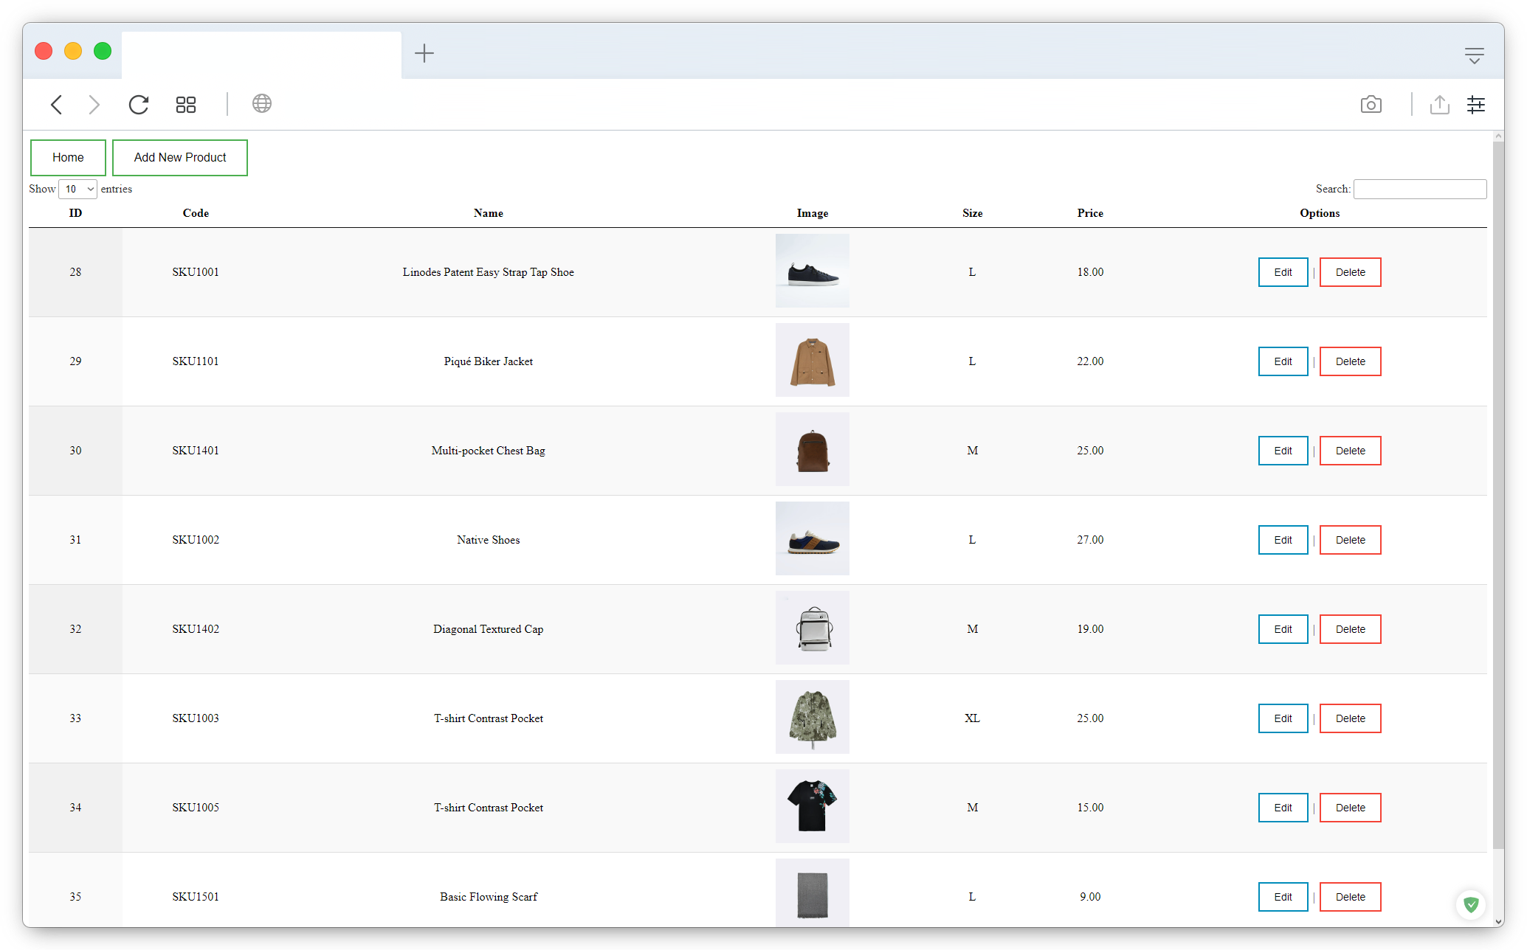
ADMIN
1
Product Page
1

Slide 4
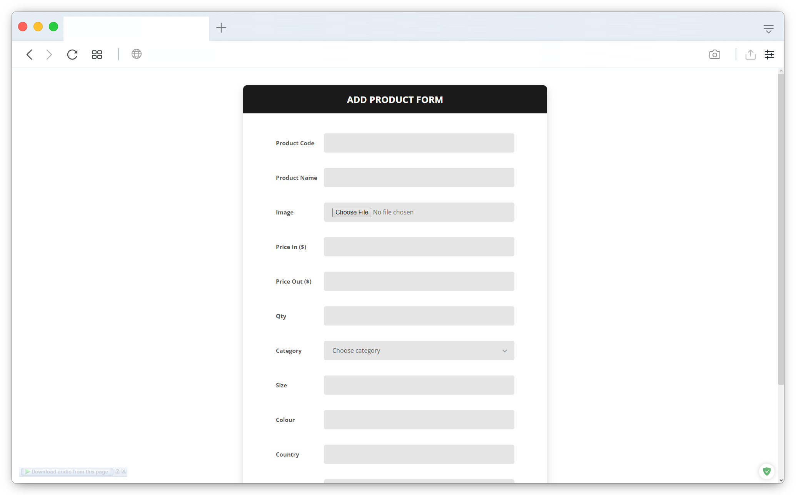
ADMIN
2
Add Product Page
2

Slide 5
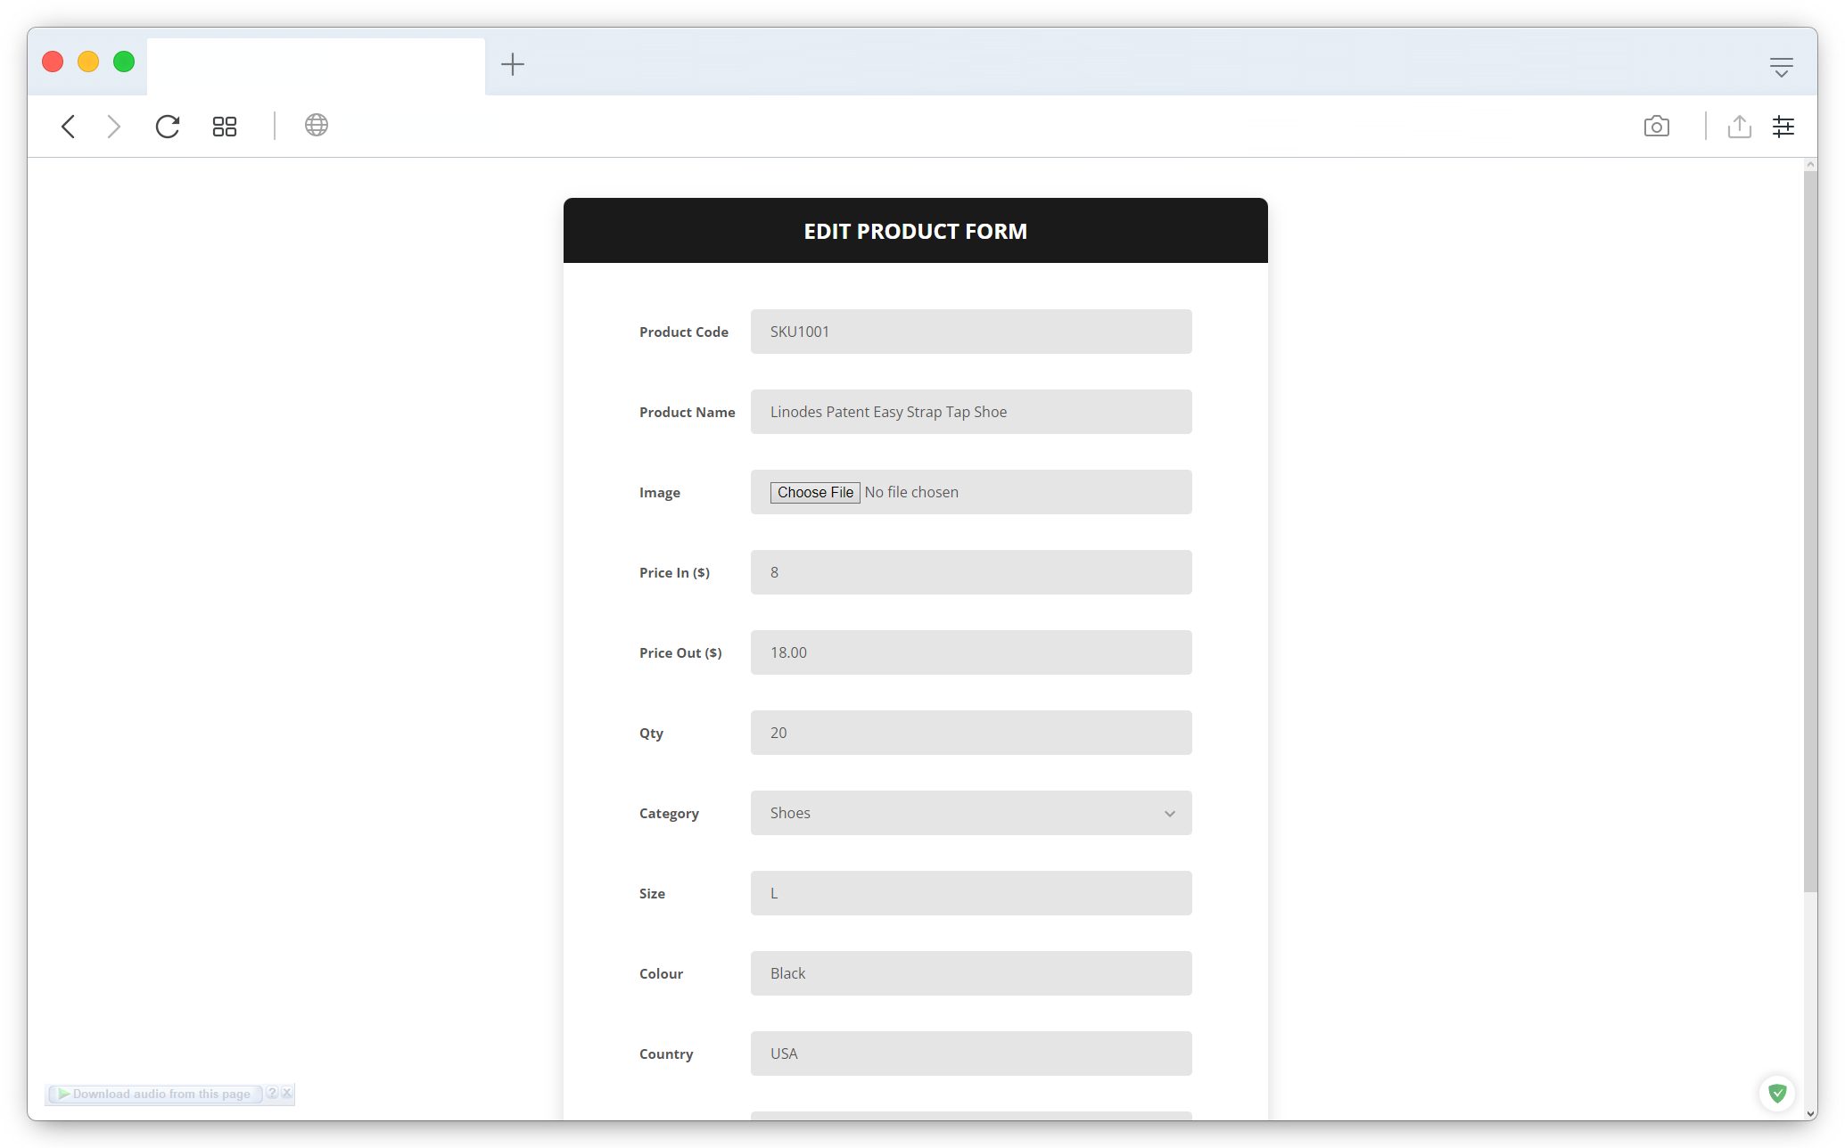
ADMIN
3
Edit / Delete Product Page
3

Slide 6
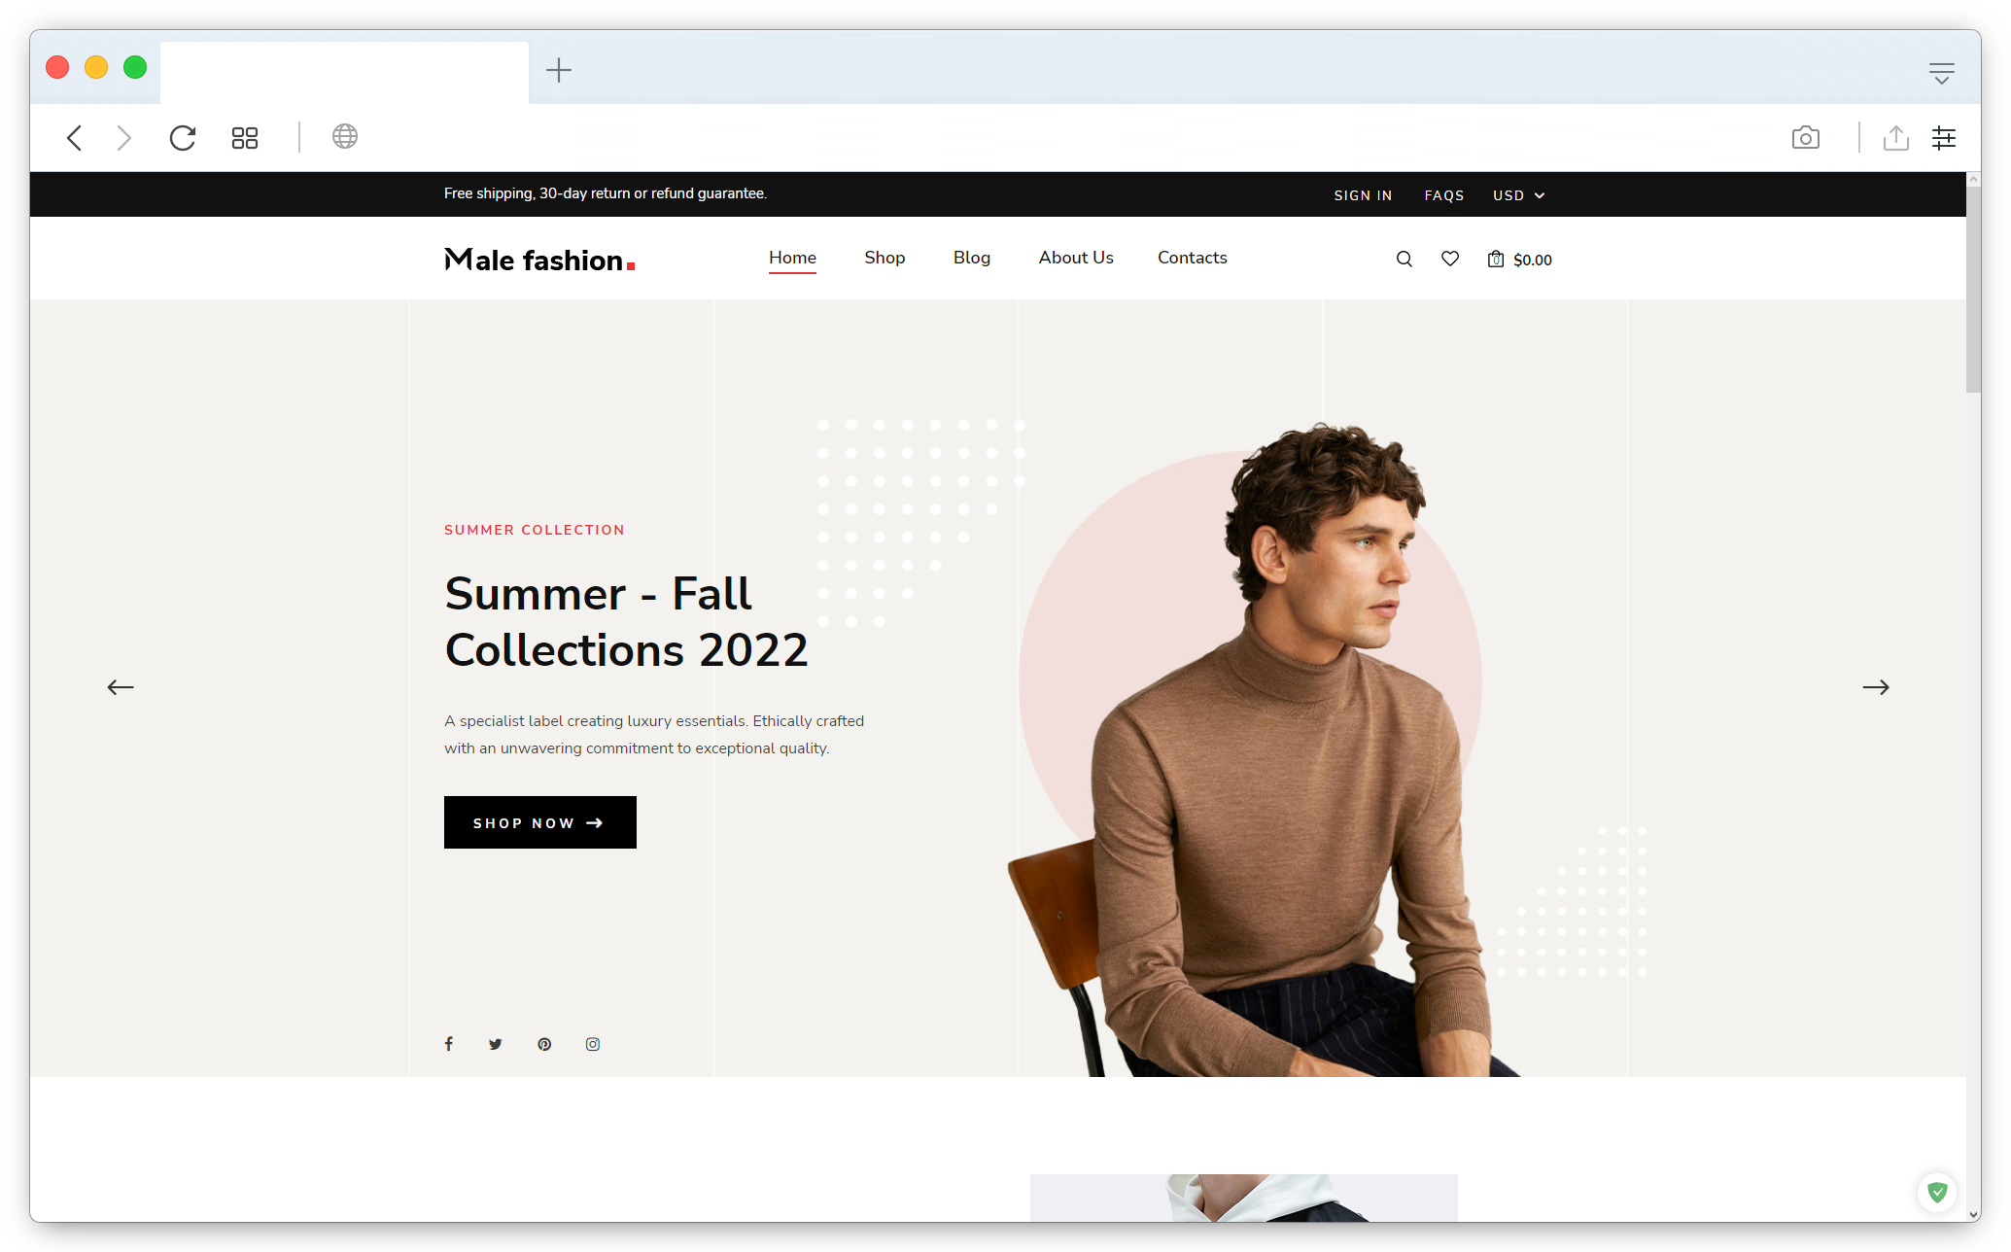
FRONT
END
1
Home Page
4

Slide 7
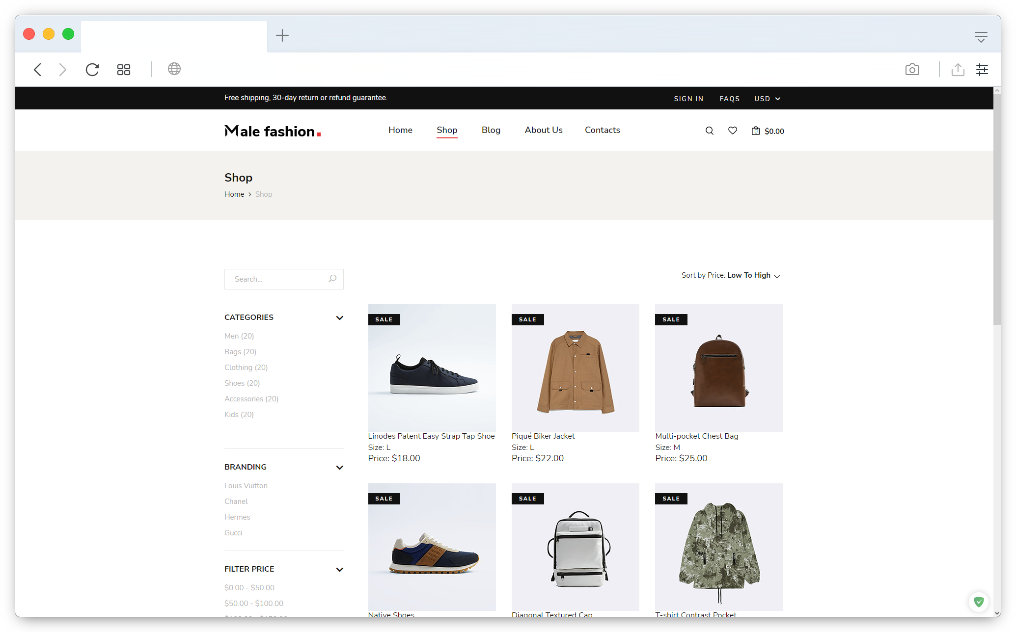
FRONT
END
2
Shop Page
5

Slide 8
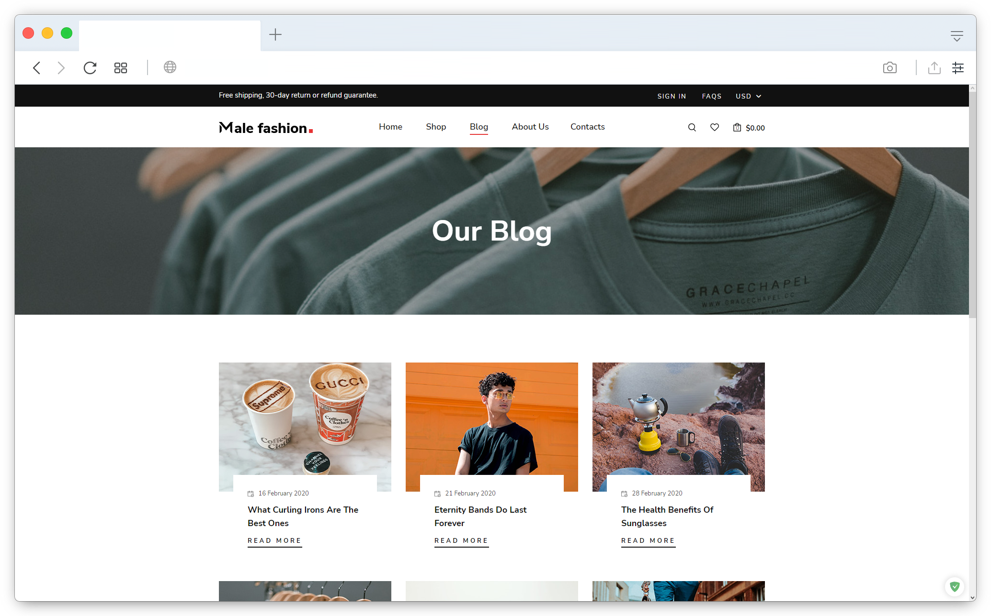
FRONT
END
3
Blog Page
6

Slide 9
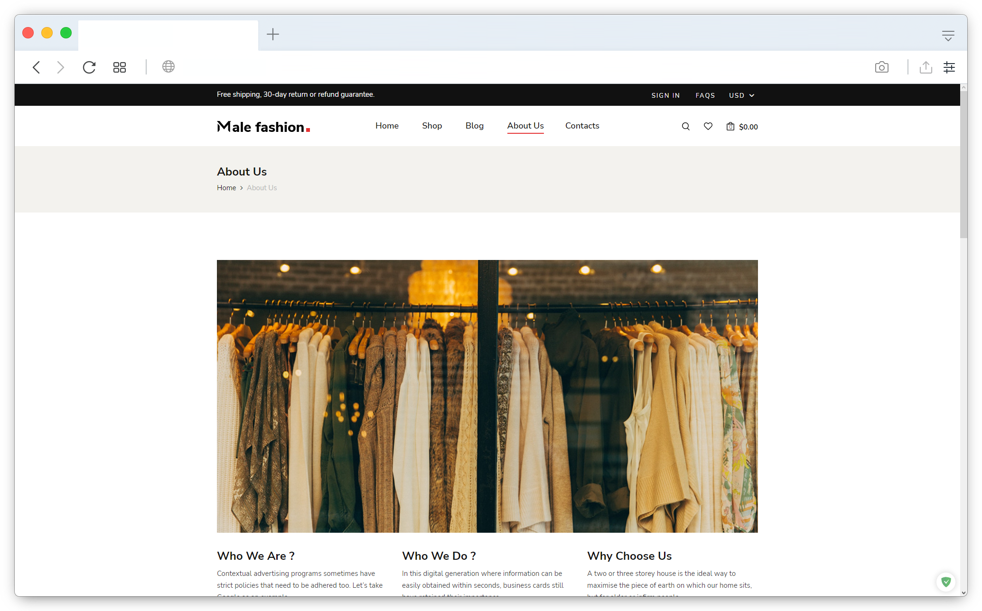
FRONT
END
4
About Page
7

Slide 10
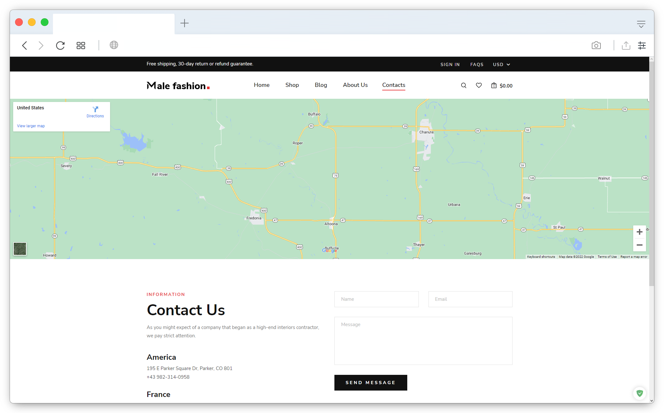
FRONT
END
5
Contact Page
8

Slide 11
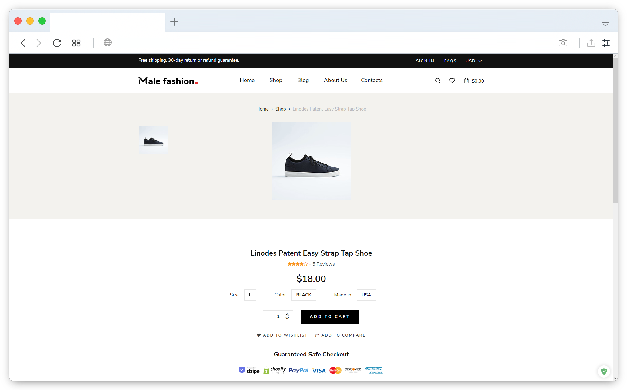
FRONT
END
6
Item Page
9

Slide 12
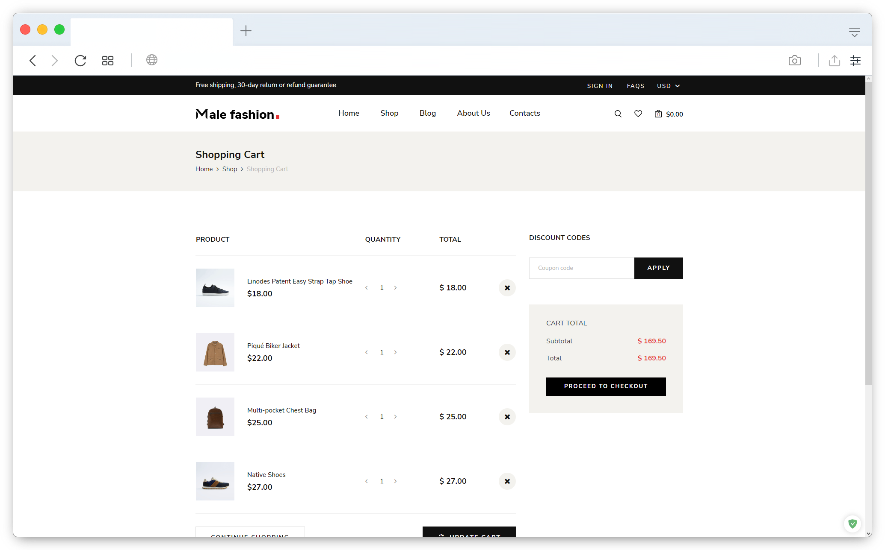
FRONT
END
7
Cart Page
10

Slide 13
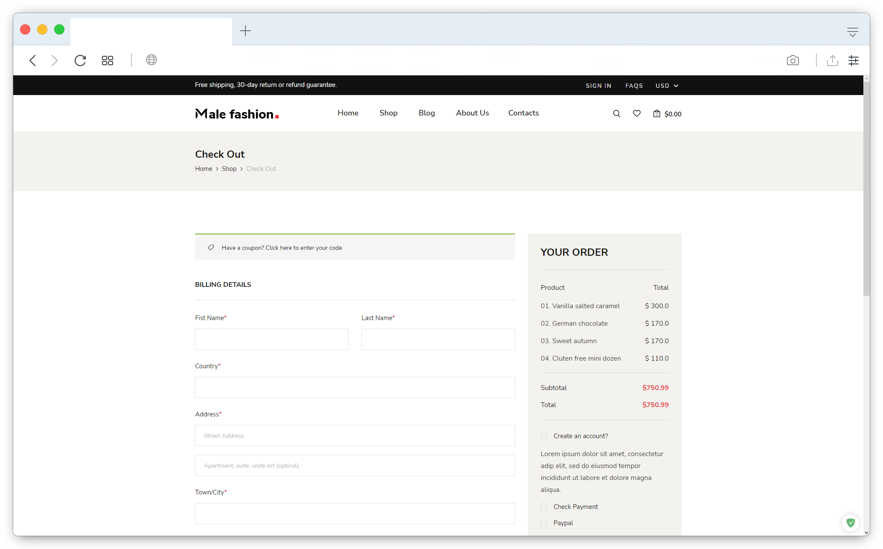
FRONT
END
8
Checkout Page
11

Slide 14
THANK YOU

